Slide 1


REDUCTION OF MACHINE DOWNTIME

Slide 2
Contents
Business Objective
Business Constraints
Project Architecture - Data Flow Diagram
Data Collection
Exploratory Data Analysis
Data Visualization
Notes:
Change

Slide 3
Business Problem
"Client: One of the leading vehicle fuel pump manufacturers. These pumps are used to take fuel as input and push fuel as output at a high velocity. More the velocity, more is the speed at which vehicle will move.
Business Problem: Machines which manufacture the pumps. Unplanned machine downtime which is leading to loss of productivity.
Business objective: Minimize unplanned machine downtime.
Business constraint: Minimize maintenance cost.
Business success criteria: Reduce the unplanned downtime by at least 10%.
Economic success criteria: Achieve a cost saving of at least $1M"

Slide 4
Project Overview and Scope
Project Overview:
The project aims to minimize unplanned machine downtime in the manufacturing of vehicle fuel pumps, addressing significant productivity losses. By leveraging a dataset containing operational parameters such as pressures, temperatures, vibrations, and speeds, we seek to reduce downtime by at least 10% and achieve $1M in cost savings. Data preprocessing involves cleaning, normalizing, and handling missing values to ensure data integrity. Subsequent exploratory data analysis (EDA) and predictive modeling will uncover patterns and provide actionable insights. The ultimate goal is to enhance machine reliability and optimize maintenance strategies, driving efficiency and reducing
costs.
Scope:
Data Collection and Analysis: Gathering and historical machine performance and downtime data.
Exploratory Data Analysis(EDA): Identifying patterns and key factors contributing to downtime.
Data Preprocessing: Cleaning and normalizing for accurate modelling.
Predictive Modelling: Developing models to forecast potential downtime incidents.
Implementation and monitoring: Implement solutions and set up real-time monitoring systems.
Reporting and visualization: Creating reports and dashboards for stakeholders communication.

Slide 5
Data Dictionary
Column Name | Datatype | Description
Date | DATE | The date when the data was recorded.
Machine_ID | VARCHAR(50) | Unique identifier for the machine.
Assembly_Line_No | VARCHAR(50) | Identifier for the Assembly_Line where the machine is located.
Hydraulic_Pressure | DECIMAL(20,2) | Hydraulic pressure in bars.
Coolant_Pressure | DECIMAL(20,2) | Coolant pressure in bars.
Air_System_Pressure | DECIMAL(20,2) | Air System pressure in bars.
Coolant_Temperature | DECIMAL(20,2) | Coolant temperature in degree Celsius.
Hydraulic_Oil_Temperature | DECIMAL(20,2) | Hydraulic Oil temperature in degree Celsius.
Spindle_Bearing_Temperature | DECIMAL(20,2) | Spindle Bearing temperature in degree Celsius.
Spindle_Vibration | DECIMAL(20,2) | Spindle Vibration in micrometres.
Tool_Vibration | DECIMAL(20,2) | Tool Vibration in micrometres.
Spindle_Speed | INT | Spindle Speed in Revolution Per Minute(RPM).
Voltage | DECIMAL(20,2) | Voltage in volts.
Torque | DECIMAL(20,2) | Torque in Newton meters(Nm).
Cutting | DECIMAL(20,2) | Cutting force in kilonewtons(kN).
Downtime | VARCHAR(50) | Downtime in minutes.

Slide 6
Exploratory Data Analysis [EDA]
Statistical Insights
Business Insights
Total records : 2500
Failure distribution:
Machine Failure instances: 1265
No_Machine_Failure instances : 1235
● Most Common Machine_ID: Makino_L1_Unit1_2013.
● Most Common Assembly_Line_No: Shopfloor-L1
The failure rate of the fuel pump manufacturing process is approximately 51.68%.
The success rate of the fuel pump manufacturing process is approximately 48.32%, suggesting that the manufacturing process can be improved to reduce machine failures and enhance production efficiency.
The high failure rates highlights a critical need for process optimization to improve the reliability and performance of the manufacturing system.
Notes:
EDA is used for seeing what the data can tell us before the modeling task.
Change

Slide 7
Data Preprocessing
The dataset under consideration includes operational parameters collected from machines involved in vehicle fuel pump manufacturing. Proper preprocessing is crucial for ensuring data quality, facilitating accurate analysis and generating reliable insights.
Steps in Data Preprocessing:
1. Data Loading:
Imported the dataset into a MySQL database for structured storage and analysis.
Ensured correct handling of various datatypes, including Dates, numeric values and categorical data.
2. Handling Missing Values:
Checked for null or missing values across all columns.
Applied appropriate strategies to handle missing data, such as replacing empty fields with nulls during the data import to maintain the integrity of numerical columns.
3. Data Cleaning:
Addressed issues like incorrect data formats, particularly for numeric columns like dates, pressures and temperatures.
Ensured that the ‘Assembly_Line_No’ column retained its categorical nature without data truncation.
Notes:
Keep observations

Slide 8
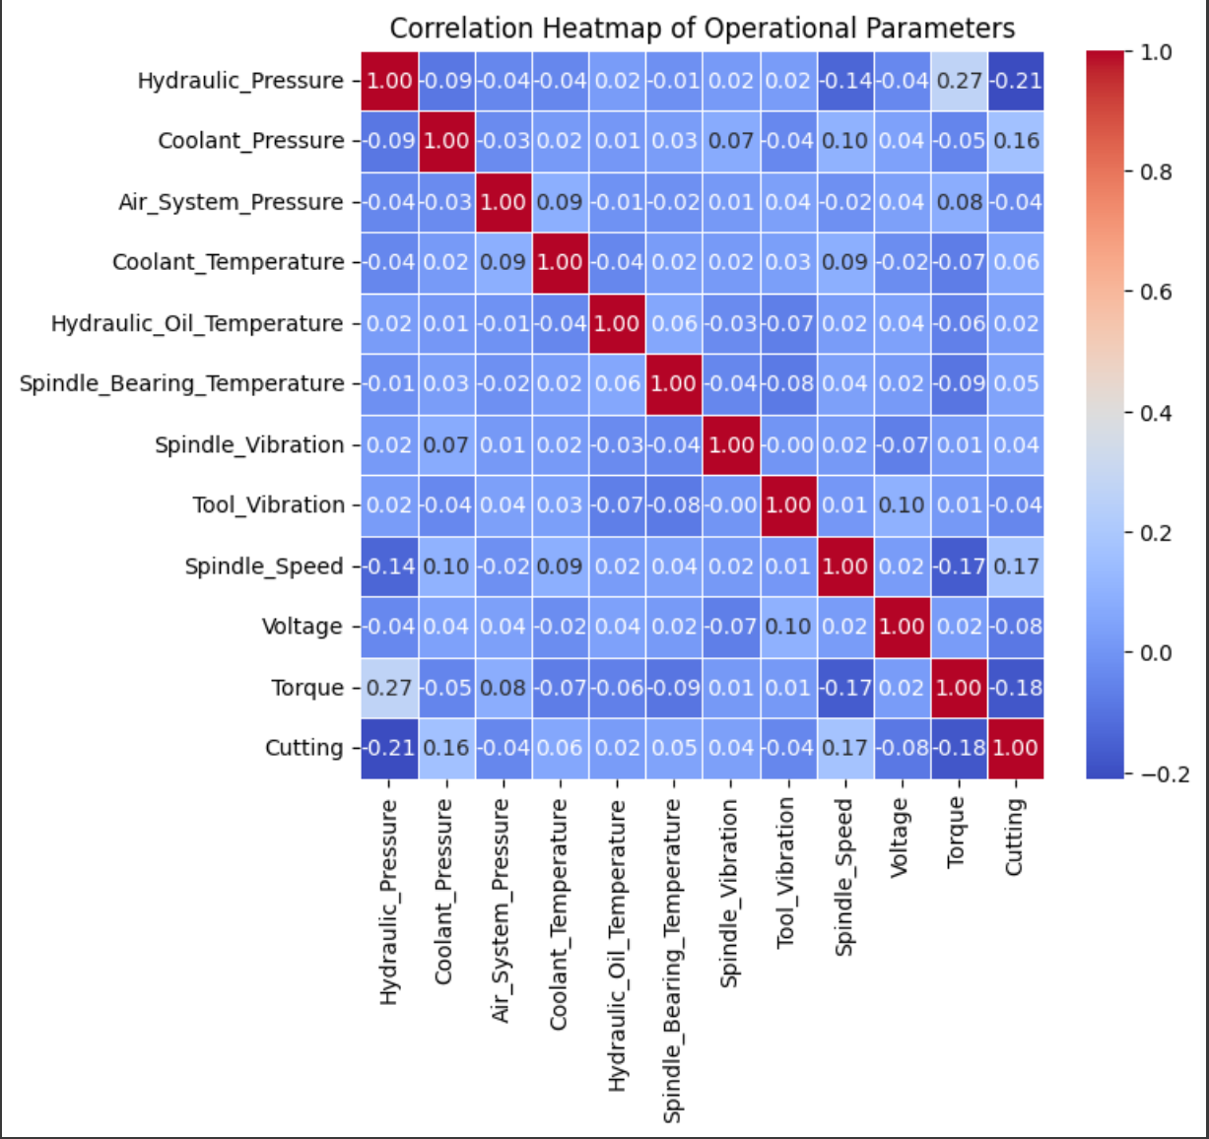
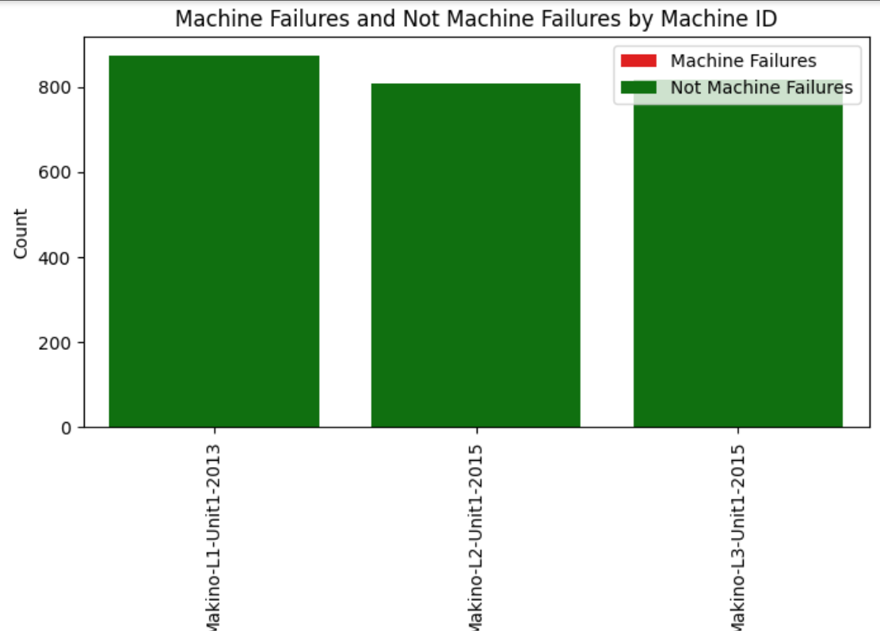
Data Visualization
Notes:
Add graphical

Slide 9


